Slide 1
معرفی پروژه Bicycle Sales Management

Slide 2
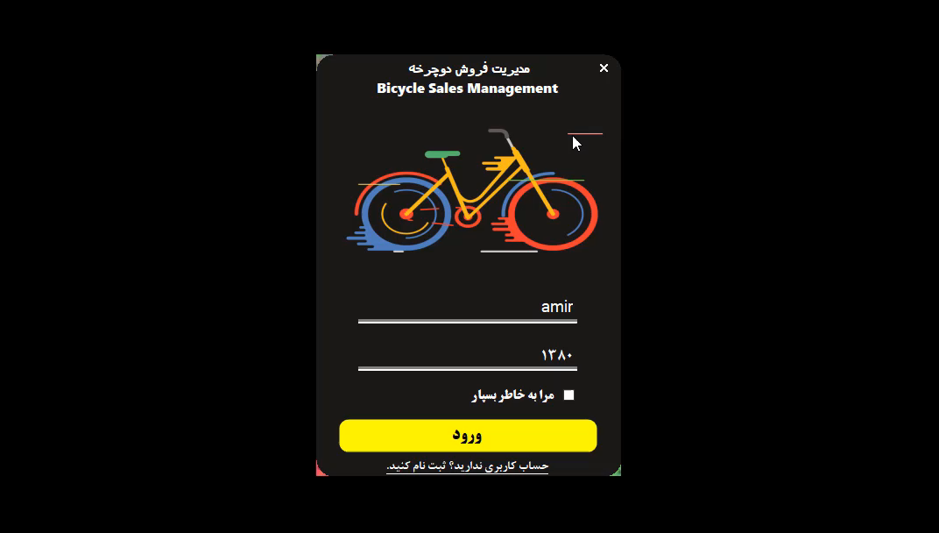
Bicycle Sales Management

